Slide 1
Lesson 5– Homework review

Slide 2
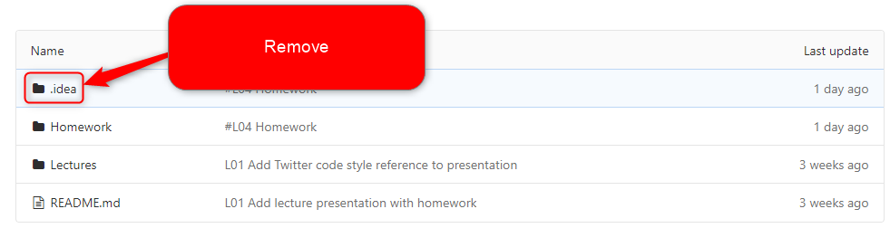
Do not track non business code

Slide 3

Commit atomically

Slide 4

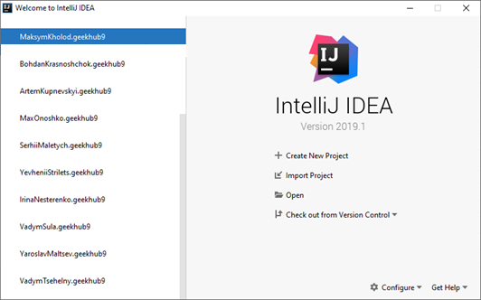
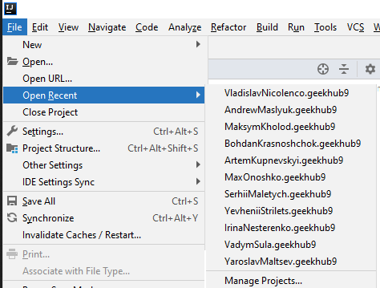
Follow Single Responsibility
History 1
History 2

Slide 5
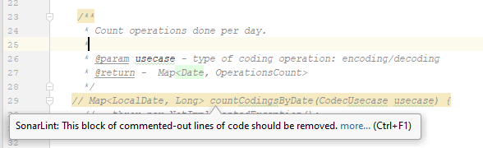

Do not commit unused code

Slide 6


Depend on abstraction, but not details

Slide 7
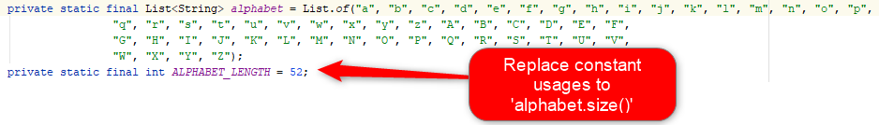
Do not couple data

Slide 8
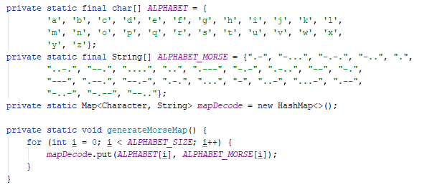
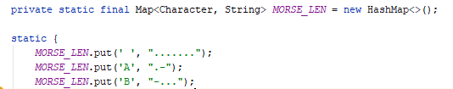
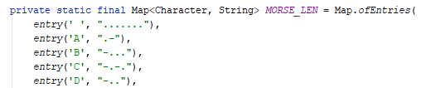
Know your tools

Slide 9
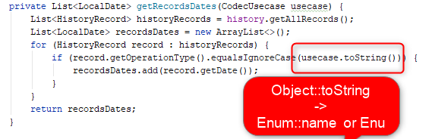
Never use toString for business logic

Slide 10

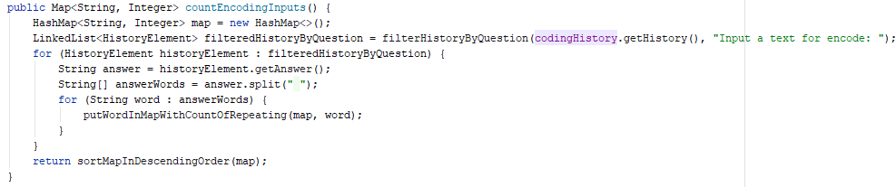
Use effective data structures: HistoryEntry

Slide 11
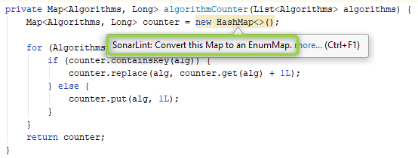
Use effective data structures: EnumMap

Slide 12
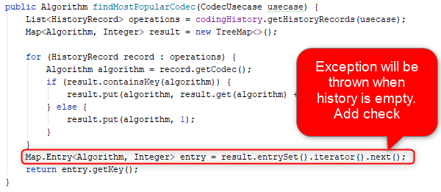
Check edge-cases

Slide 13
Apply recommendations from personal feedbacks before starting next homework

